Slide 1
IDENTIFICATION OF FAKE LINKS USING BLOCKCHAIN TECHNOLOGY
PAPER ID: 4TH ICETEM-2021-011
SURESH L
VENGATESH HARI PRABU J
NITHESH KUMAR S
THIANESH G
PRATHEEP K S

Slide 2
ABSTRACT
During the lockdown period, many people faced financial problems by staying home. Many of the people lost their jobs and starved for money.
There are also some people who earn online through some gaming application, some of the people don't go to the side of online income because of the doubt of insecurity.
But there are some really good apps which afford money when we play games or when we do online trading.
This idea is for the people to identify the true earning website so that the people can utilize this platform and get benefit through it.
Our conceptual model addresses the fraudulent activities through blockchain linked online websites.

Slide 3
INTRODUCTION
URLs are the homes of content on the web. Without them, we would never be able to navigate through the Internet.
While most web links are perfectly safe and take you exactly where you expect them to, scammers are increasingly making use of a fake URL or two to compromise your safety and privacy online.
Fake URLs can serve a variety of purposes. In some cases, they’re able to infect your devices with malware or even viruses.
Other times, they pose as a real website, ask you to log in, and then steal your data. In this paper we are trying to make a model to identify the fake URL.

Slide 4
CHARACTERISTICS OF BLOCKCHAIN
Immutability: In a blockchain system, all transactions are digitally signed and encrypted by one-way hash functions. . The collision resistance property of the hash function makes the shared ledger immutable, and thus builds a firm foundation for secure transactions among peer nodes. This feature helps to maintain data security in a computer network.
Decentralized consensus: Blockchain systems run completely in a peer-to-peer manner without a centralized third party. The data in blockchain can be recorded, stored, and updated by decentralized consensus in a secure and convenient manner. This feature also increases the resistance to attacks and avoids the problem of single points of failure in the centralized model.
Trustworthiness: The blockchain technology imposes a trust mechanism based on majority votes. The trusted third party, which is quite common in a central system, is replaced by the consensus mechanism. Thus, it builds up trust among strangers and can be further utilized to optimize the future computer networks.

Slide 5
OPERATION TYPES OF BLOCKCHAIN
Public blockchains: A public blockchain is designed to be fully decentralized and permission less. They allow anyone to participate as a user, miner, developer, or community member. . Bitcoin may be considered as the best example of a public blockchain.
Private blockchains: Unlike public blockchains, participants in a private blockchain need to obtain an invitation or permission to join the private blockchain network. It is often used as a synchronous distributed database and can operate without a digital currency .
Consortium blockchains: A consortium blockchain is similar to a private blockchain in some respects, but it is controlled by multiple approved agents rather than a single entity. The consortium blockchain has the inherent security as in a public blockchain, while it also allows for greater control over the network by the group of agents.

Slide 6
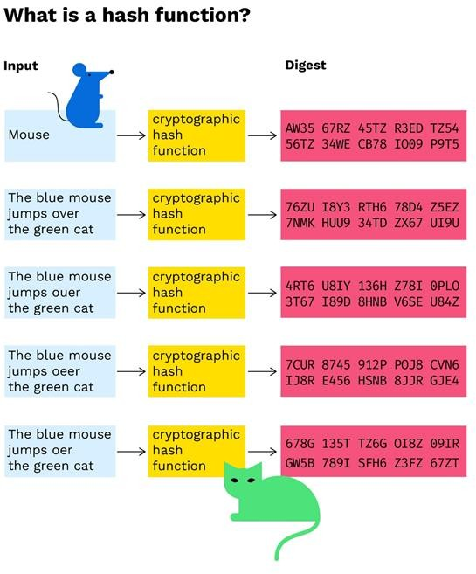
METHODOLOGY
If you put some information using block chain technology, it will create a hash value for every single information and it will create a block using hash value . A hash is a function that meets the encrypted demands needed to solve for a blockchain computation. The same data will always produce the same hashed value. A hash, like a nonce or a solution, is the backbone of the blockchain network. A hash is developed based on the information present in the block header. So if you put the true link in blockchain technology spammers will not be able change or duplicate the links.

Slide 7
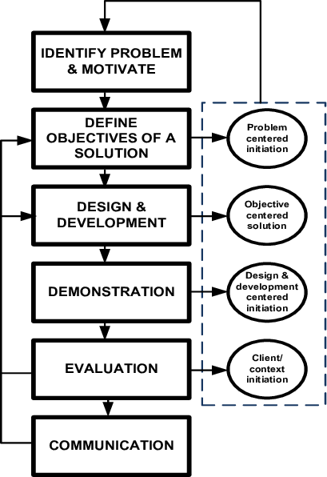
DSR METHOD
Design science research methods are also used to find fake links.
It uses link layer feedback when possible, which is also the fastest mechanism of these three to detect link errors.
A link is considered to be broken if frame transmission results in a transmission failure for all retries.
This mechanism is meant for active links and works much faster than in its absence.
DSR is able to detect the link layer transmission failure and notify that as broken.

Slide 8
IMPLEMENTATION
STAGE I: Product enrollment on the network:
Initially the manufacturer will be the first owner of the product. Manufacturer will request administrator to add product on the network at that time QR code will get assigned to that product.
STAGE II: Ship product to Distributor:
In the next step manufacturer will ship the product to distributor and status is set as shipped it will not change the ownership of product until Acknowledgement from distributor is received.
STAGE III: Ship product to retailer:
In this stage distributor will ship the product to retailer and status is set as shipped and after receiving ACK from retailer that product received successfully, ownership of that product is given to retailer.
STAGE IV: End user get detail about product:
In this stage the customer will be provided an android app and the buyer can scan the QR code assigned to the product using android app and get the details about the manufacturer and current owner of the product and can decide whether to buy the product or not.

Slide 9
CONCLUSION
Thus, proposed system is useful for end user to detect fake products in supply chain. End user can scan QR code assigned to a product and can get all the information like transaction history, current owner based on which end user can check whether the product is genuine or not.
In future we will implement the system which controls and monitors product transportation details.

Slide 10
REFERENCE
https://www.bitpanda.com/academy/en/lessons/what-is-a-hash-function-in-a- blockchain-transaction/
https://www.researchgate.net/publication
/345430098_Introduction_to_Design_Science_Research
https://ieeexplore.ieee.org/document/884397
https://hbr.org/2017/01/the-truth-about-blockchain

Slide 11
Thank you…

